Slide 1
Economic Analysis of Government Spending

Slide 2
Introduction
This project involves the analysis of government spending data to identify trends, anomalies, and misalignments, and to assess economic impact. It uses techniques such as data cleaning, time-series analysis, sector-wise analysis, policy-spending alignment analysis, economic impact analysis, and machine learning modelling. The project aims to understand spending patterns across different sectors, identify policy-spending misalignments, and explore the correlation between government spending and GDP per capita growth. This will help in identifying inefficiencies and understanding the impact of government spending on broader economic activity.

Slide 3
Methodology
Data Collection and Preparation
Policy and Spending Misalignment Analysis
Sector-Wise Analysis
Time-Based Analysis:
Regional and Country-Level Analysis:

Slide 4
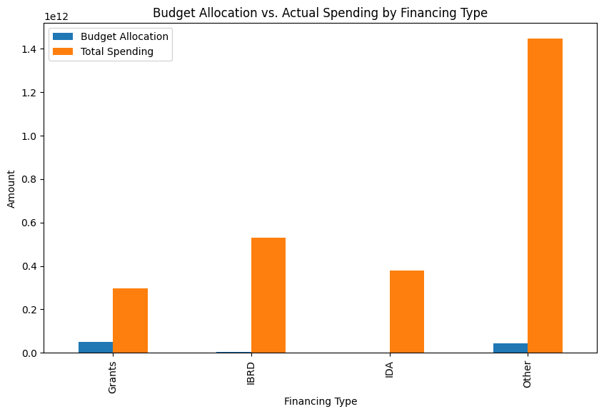
Findings and Analysis
Total spending exceeds budget allocation, and the gap is widening.
Highest overspending in "Other" financing type, lowest in "Grants."

Slide 5
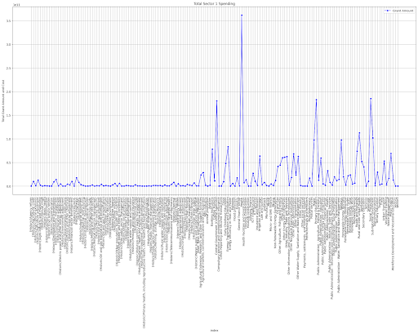
Sector-Wise Analysis
Sector 1
Project cost stagnant, grant amount stable, suggesting government prioritizes grants over projects. Current project cost fluctuates more than grant amount, suggesting project spending is more erratic and unpredictable. Gap between total grant amount and current project cost widening, suggesting government underspends on projects or overspends on grants.

Slide 6
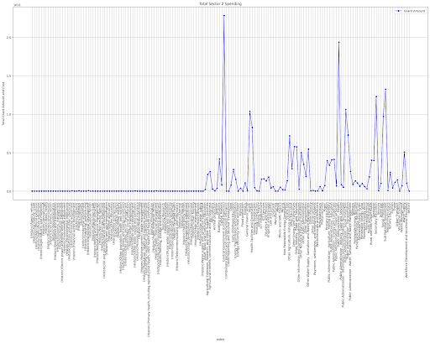
Sector 2
Government spending on grants increasing steadily, while project cost remains stagnant. Project spending more erratic and unpredictable, while grant spending more stable. Growing gap between grant spending and project cost suggests government underspends on projects or overspends on grants.

Slide 7
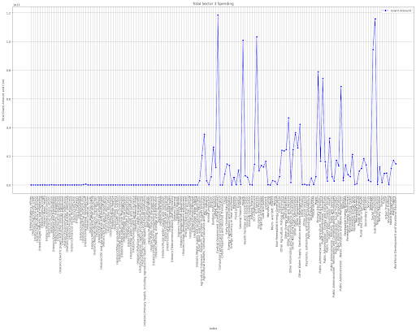
Sector 3
Grant spending increases steadily, project cost stagnant. Either more projects funded or larger grants, project spending relatively consistent. Widening gap suggests grant overspending or project underspending.

Slide 8
Time Series analysis
Total grant amount has been increasing steadily over time, while the current project cost has been relatively stagnant. This suggests that the government is either giving out more grants or increasing the average grant amount.
There have been fluctuations in the current project cost over time, but the overall trend has been flat. This suggests that the government's spending on projects has been relatively consistent.
The gap between the total grant amount and current project cost has been widening over time. This suggests that the government is either overspending on grants or underspending on projects.

Slide 9
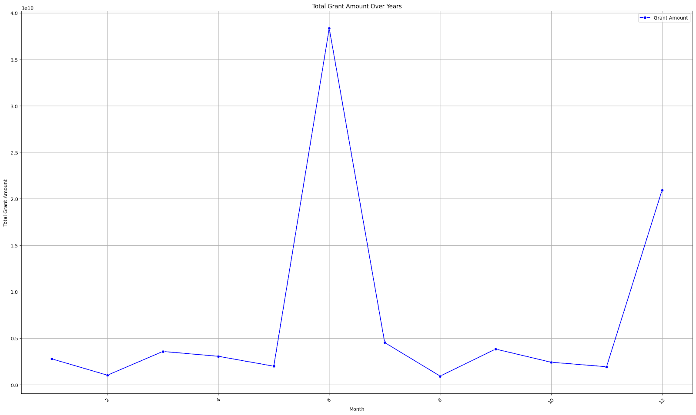
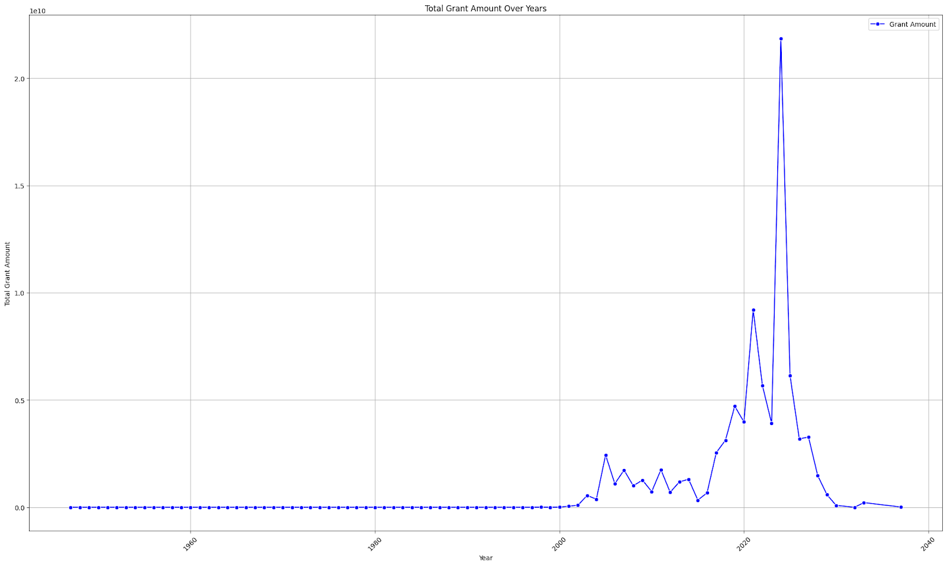
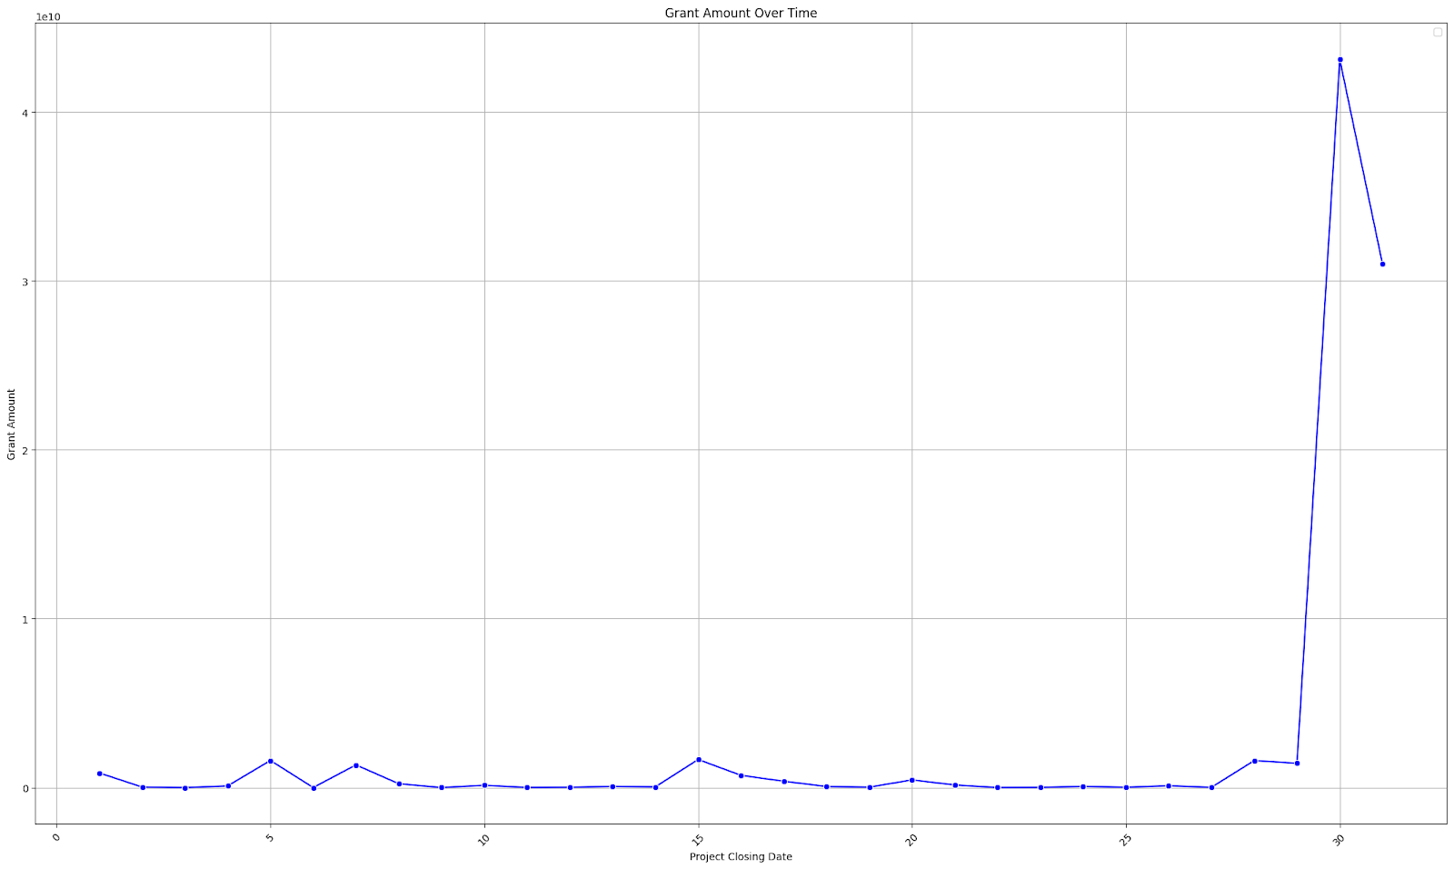
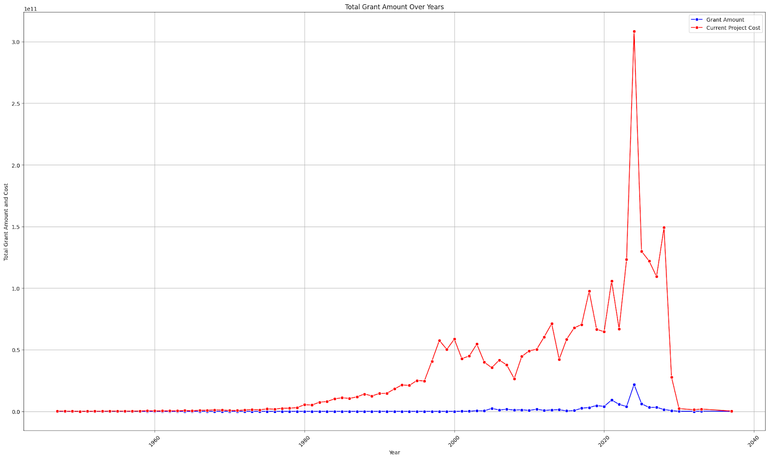

Slide 10
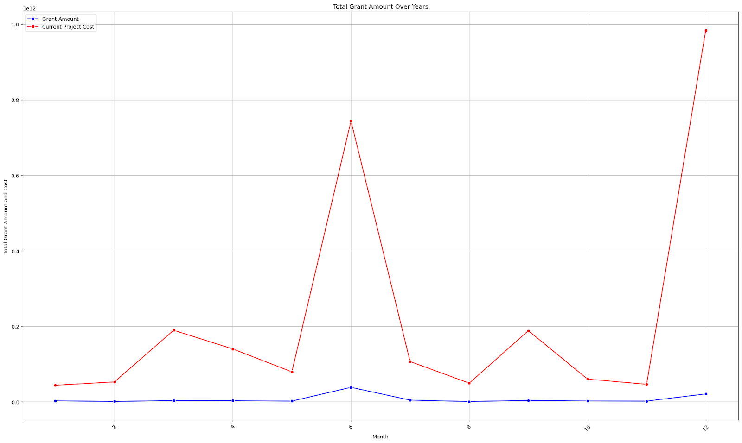
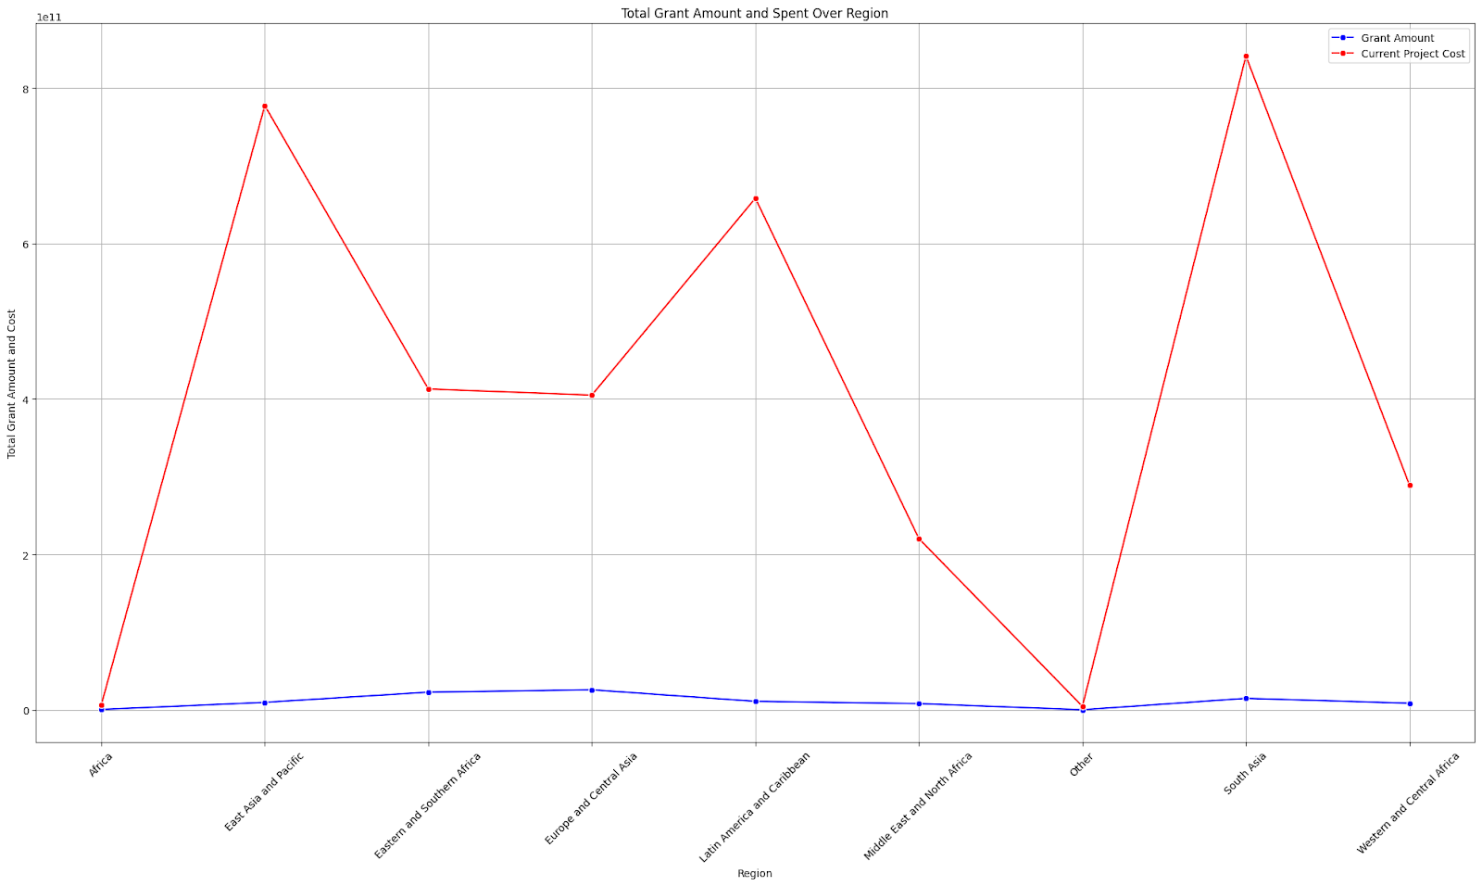
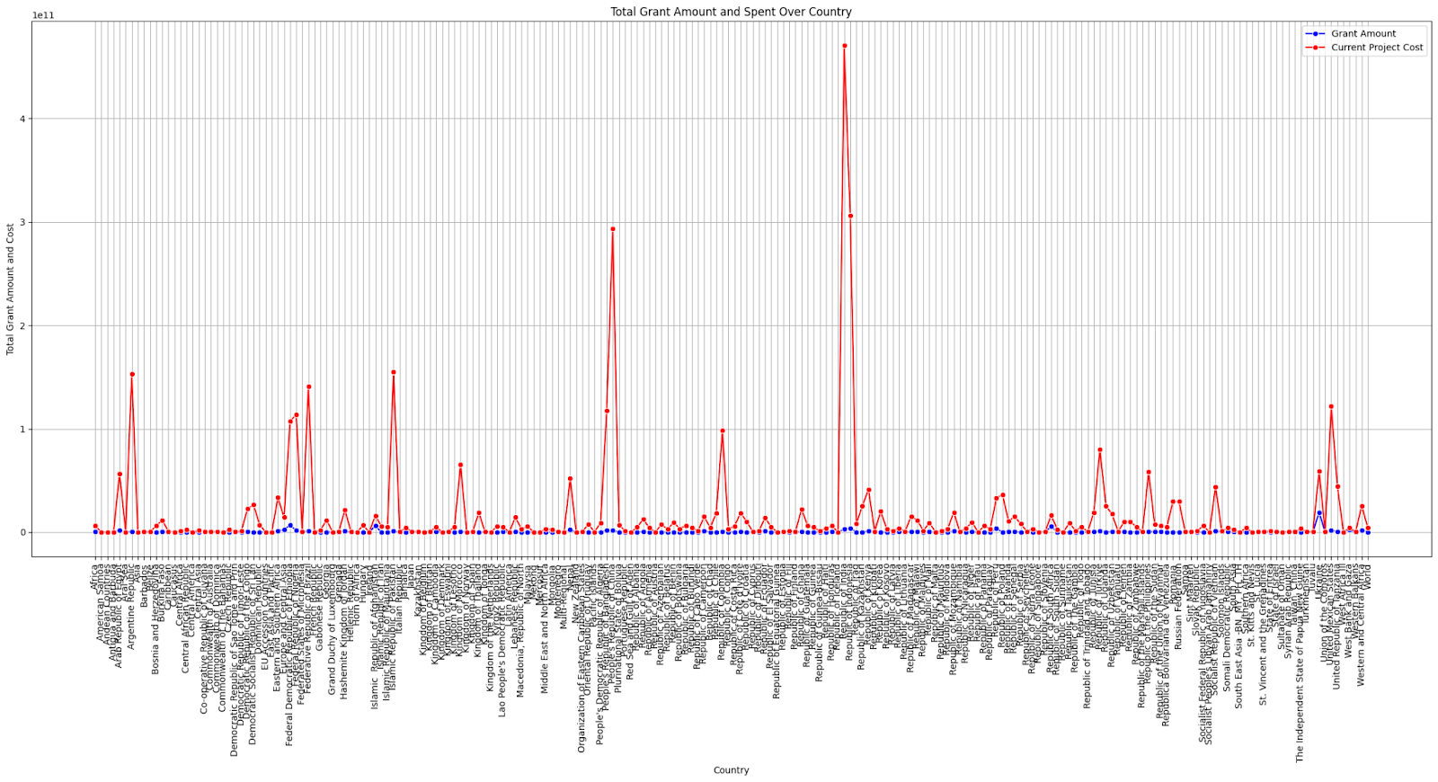

Slide 11
Conclusion and Recommendations for Time Series:
Grant amount has increased over the years, with a few exceptions.
Possible explanations for the increase: more government support, increased cost of R&D, increased number of grant applicants.
Red line in graph represents spent grant amount.
Spent grant amount generally follows the trend of total grant amount, but there have been years when it has been higher or lower.
Difference between red line and blue line can give insights into how much country progress will be affected.
Larger difference between red and blue lines is likely to have a greater impact on country progress.
If the difference is large and the country is spending more grant money than it is receiving, this could lead to a slowdown in economic growth.
If the difference is large and the country is saving up grant money, this could lead to missed opportunities for development.
If the difference is small, this suggests that the country is spending grant money wisely and investing it in development projects.

Slide 12
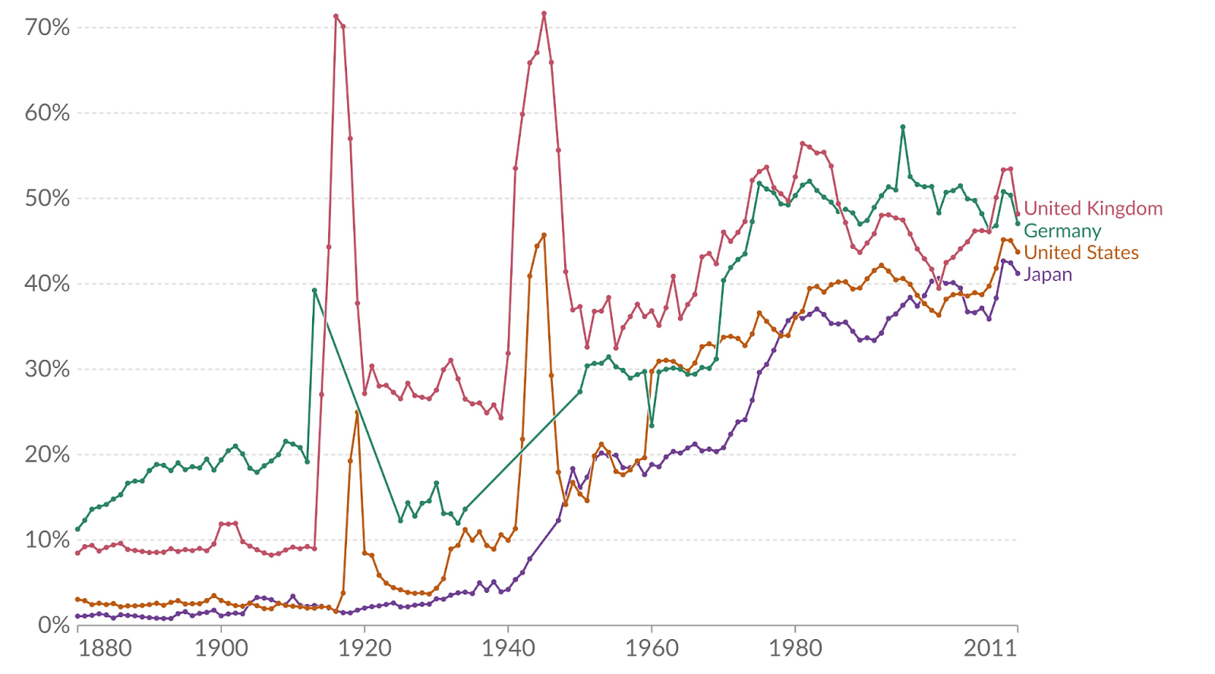
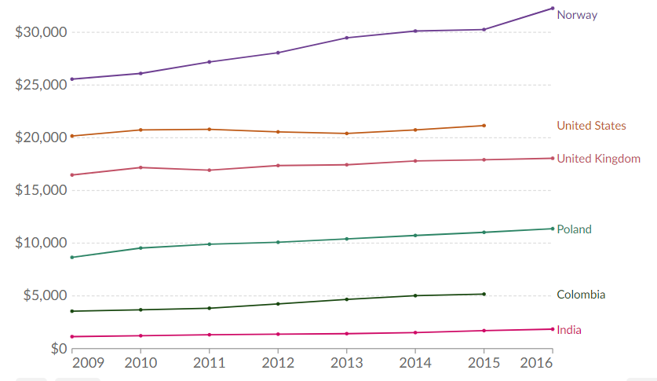
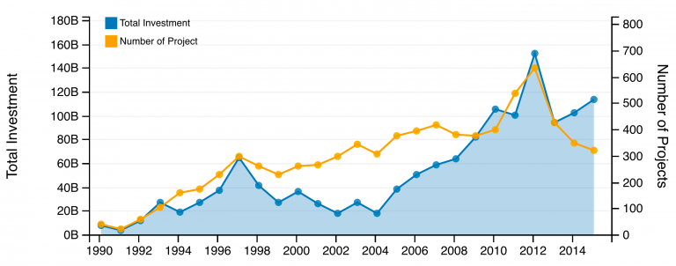
Conclusion and Recommendations for Economic impact analysis:
Total government spending, including interest government expenditures, as share of national GDP
Total government expenditures across all levels of government. Expenditures include intermediate consumption, compensation of employees, subsidies, property income, and social benefits
.
Total investment (billions of US dollars) and number of PPP projects in low and middle income countries, 1990-2015

